Slide 1
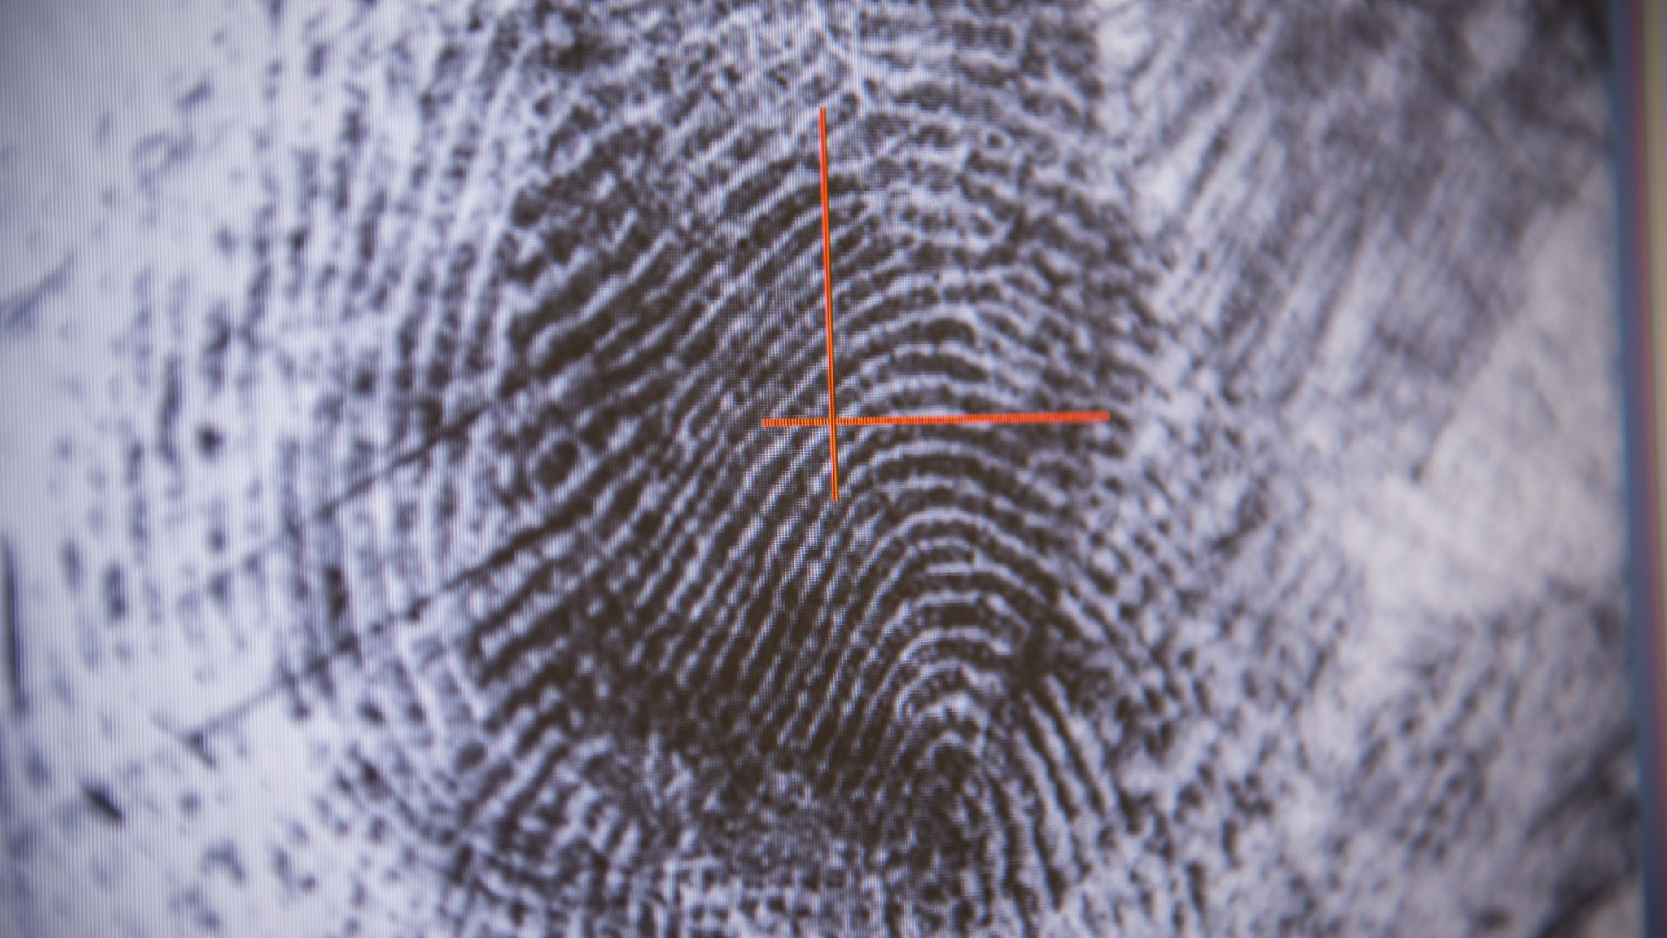
DriveAlert Vigilance AI

Slide 2



Mohammad Rabbani
Senior ML Engineer
Dharanidhar Manne
Computer Vision Expert
Rama Krishna
Web Developer

Slide 3
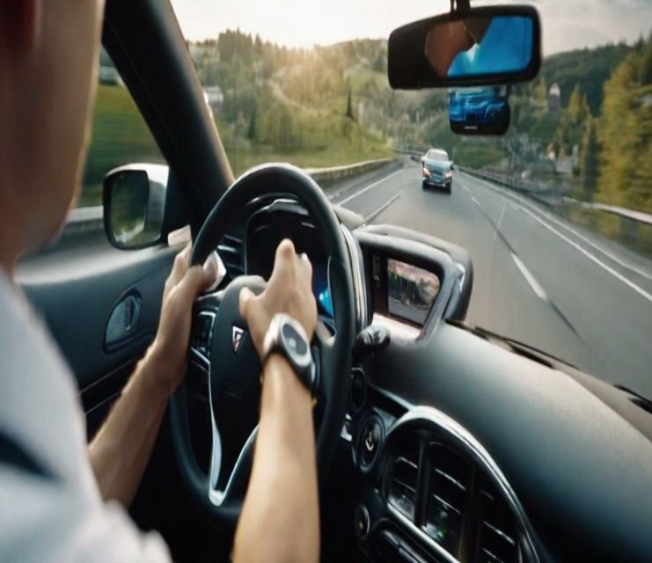
Abstract
The system aims to develop a comprehensive solution for drowsiness detection using computer vision techniques integrated with a conversational chatbot. The deep learning model will leverage Convolutional Neural Networks (CNNs) to analyze facial features and eye movements in real-time, identifying signs of drowsiness. The model will be trained on a diverse dataset to ensure robust performance across various individuals and scenarios. Upon detecting drowsiness, a chatbot will engage with the user by asking targeted questions to assess their alertness and well-being. The chatbot's interaction will serve both as a mechanism to mitigate drowsiness and as a data collection tool to enhance the model's training and adaptability. This integrated system holds promise for applications in driver safety, workplace vigilance, and other contexts where drowsiness poses a risk.
3

Slide 4

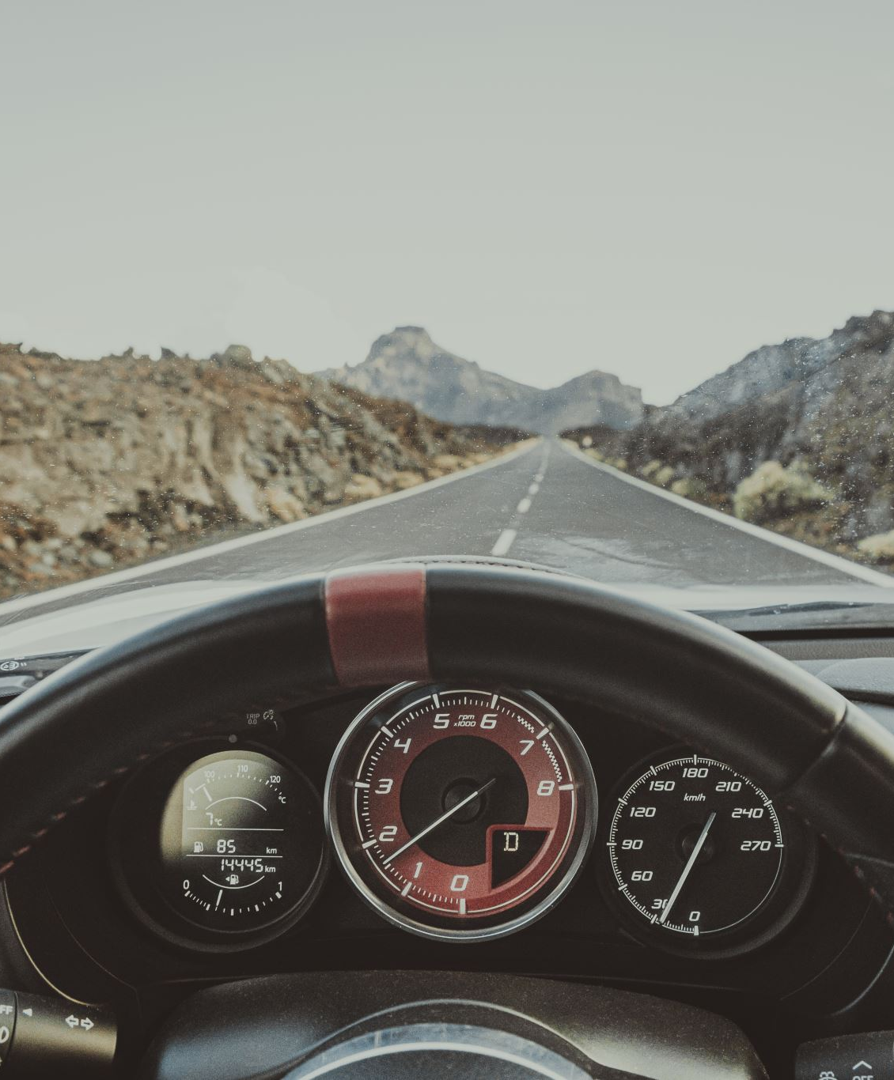
Introduction to DriveAlert
Drowsiness behind the wheel is a serious issue that affects millions of drivers worldwide. Our drowsiness detection application is designed to address this problem by utilizing _ technology to detect signs of drowsiness in drivers and alert them before an accident occurs. In this section, we will provide an overview of our application and its key features.

Slide 5

SmartEye Driver Monitoring System (DMS) Existing System:
Precision in Feature Tracking: The deep learning algorithms enable precise tracking of facial features, allowing the system to capture subtle movements such as eye blinks, gaze shifts, and changes in head pose.
Multi-Point Analysis: The technology doesn't focus on a single facial feature but combines analysis of multiple points, including eyes, mouth, and overall head movement. This comprehensive approach enhances the accuracy of interpreting driver behavior.
Adaptability to Varied Conditions: The deep learning algorithms are designed to adapt to different lighting conditions, facial expressions, and driver appearances. This adaptability ensures consistent performance across diverse driving environments.
Continuous Learning and Improvement: Deep learning facilitates continuous learning from data, allowing the system to improve its accuracy over time. As it encounters more diverse scenarios, the facial recognition technology can enhance its ability to recognize and interpret a wide range of facial expressions and movements.

Slide 6
Robust Facial Recognition:
DriverAlert Vigilance AI employs cutting-edge facial recognition technology, powered by robust deep learning algorithms.
The system ensures accurate tracking and analysis of crucial facial features, maintaining effectiveness in diverse environmental conditions and facial expressions.
Customized Alerts:
Users have the flexibility to personalize their alert preferences within DriverAlert Vigilance AI.
Tailored alarm options include audible warnings, visual cues, and haptic feedback, providing a customized safety experience for each driver.
Chatbot Engagement:
Integration of an interactive chatbot feature within the system for continuous user engagement.
The chatbot serves as a proactive measure to prevent drowsiness, engaging in conversations, periodic check-ins, and alerts to maintain driver attentiveness.
Live Graph Analytics:
Real-time monitoring through live graph analytics is a core component of DriverAlert Vigilance AI.
Graphs display dynamic metrics like eye movement patterns, head pose variations, and engagement levels, offering immediate insights into the driver's state.
Continuous Learning and Adaptation:
The system incorporates machine learning capabilities for continuous improvement.
By learning from user interactions and driving scenarios, DriverAlert Vigilance AI adapts its algorithms over time to enhance the accuracy of drowsiness and distraction detection.
Privacy-Focused Design:
Emphasizes a privacy-focused design by selectively monitoring relevant facial features without unnecessary data storage or transmission.
Adheres to stringent privacy standards, ensuring responsible handling of user data.
User-Centric Interface:
DriverAlert Vigilance AI features a user-centric interface, making it easy for users to customize settings, choose alerts, and interact with the chatbot.
The interface is designed for intuitiveness, enhancing the overall user experience.
DriverAlert Vigilance AI (Proposed System):

Slide 7
Deliverables
Convolutional Deep Learning Model-1
A trained model for drowsiness detection using convolutional neural networks.
Codebase for the model and
instructions for training on new data.
Comparing Model-1 and Model-2
Comparison of the performance of the two models on a common dataset.
Transfer Learning Model-2
A trained model for drowsiness detection using transfer learning.
Codebase for the model and instructions for training on new data.
Django Web Application
A web application that allows users to upload video files for drowsiness detection using the trained models.
Instructions for deploying and running the web application.

Slide 8

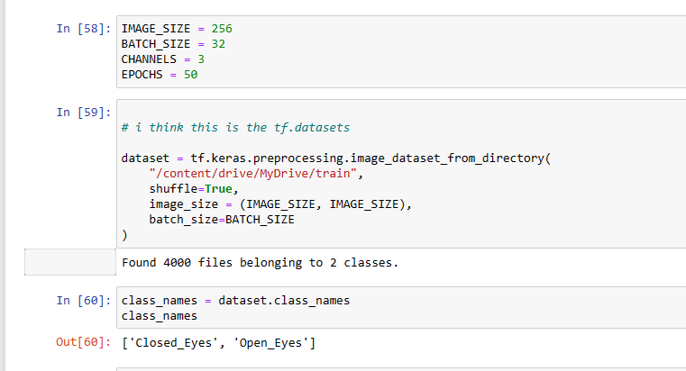
Data Understanding
The dataset comprises images of drivers' eyes categorized into classes: 'Closed_Eyes' and 'Open_Eyes.'
patterns in eye closure durations exceeding five seconds consecutively, serving as a basis for the detection algorithm.

Slide 9
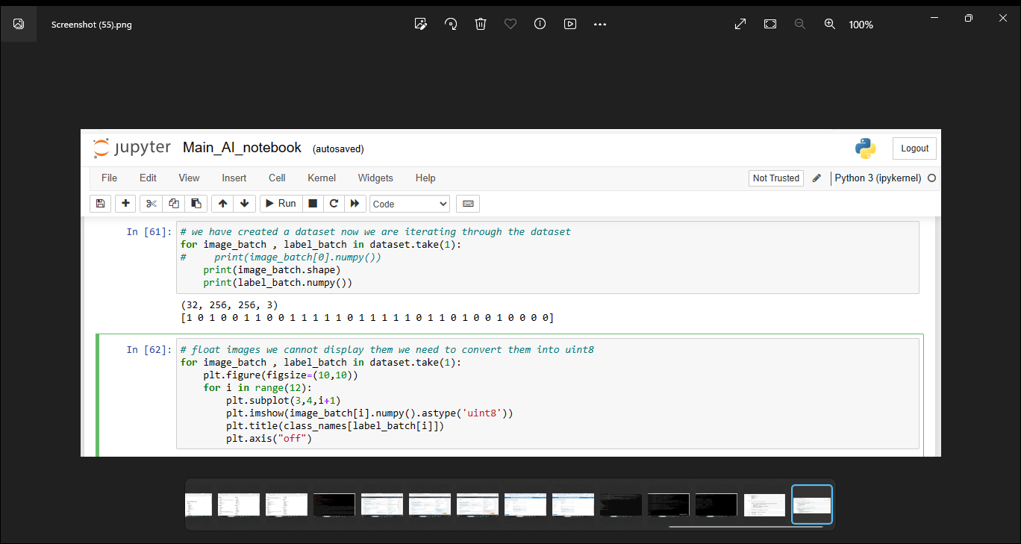
Data Preparation
Images are resized and rescaled to facilitate model training and data augmentation techniques are also applied to enhance the dataset.
The dataset is split into training, validation, and testing sets, with appropriate caching and prefetching for optimal performance.

Slide 10

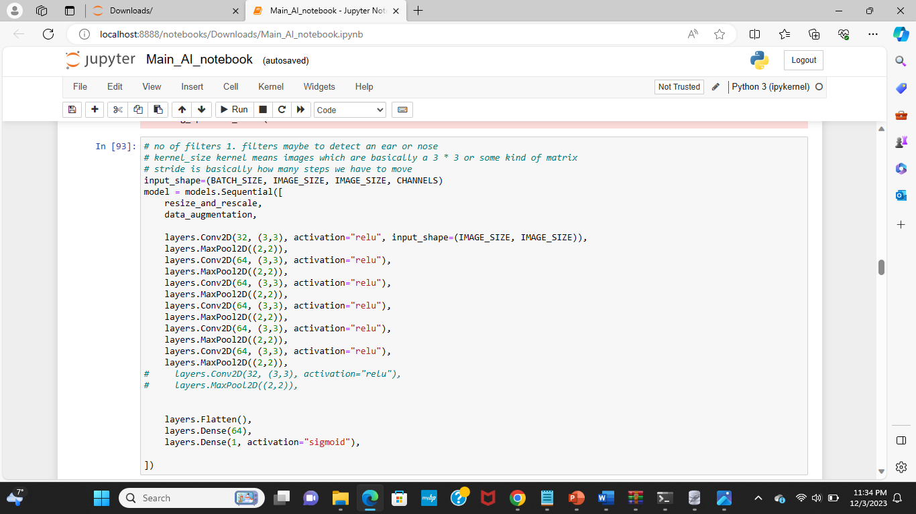
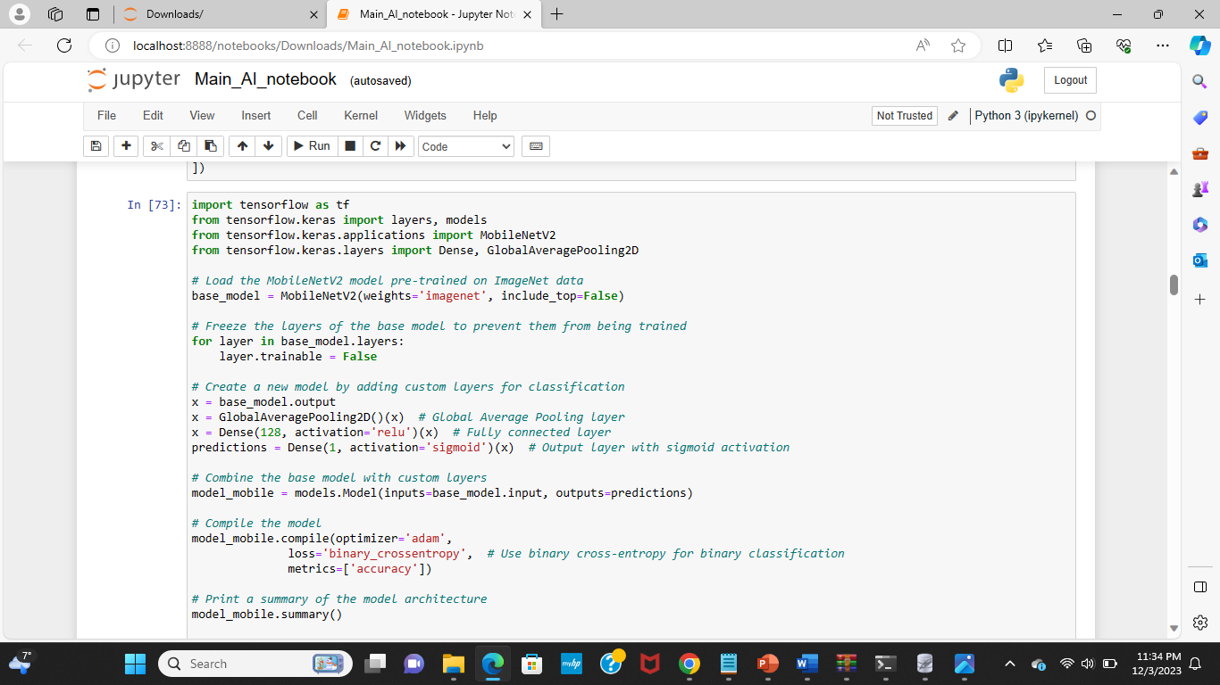
Modeling
Two distinct models are employed:
A MobileNetV2-based model for image classification.
A custom CNN model with convolutional and pooling layers.
The customized CNN model is meant for end-to-end learning, whereas the MobileNetV2 model has been pre-trained on ImageNet and optimized for our classification task.

Slide 11
Model – 1 Transfer Learning (Mobilenet V2)
MobileNetV2 is a convolutional neural network architecture designed for efficient and lightweight deep learning on mobile and edge devices. Here are a few key points about MobileNetV2:
Efficient Architecture:
MobileNetV2 is designed for efficiency, utilizing inverted residuals, linear bottlenecks, and depthwise separable convolutions to reduce computational cost while maintaining performance.
Depthwise Separable Convolutions:
The network heavily relies on depthwise separable convolutions, consisting of a depthwise convolution followed by a pointwise convolution, to decrease parameters and computations.
Width and Resolution Multipliers:
MobileNetV2 introduces width and resolution multipliers, allowing users to scale the model's width (number of channels) and input image resolution for a trade-off between accuracy and computational requirements.
Mobile and Edge Applications:
With its lightweight design, MobileNetV2 is widely used in mobile and edge devices for tasks like image classification, object detection

Slide 12

Model – 2 (Custom Model)
Convolutional Layers:
The model consists of several convolutional layers, each using a 3x3 kernel and Rectified Linear Unit (ReLU) activation function.
The number of filters in the convolutional layers progressively increases from 32 to 64, potentially capturing more complex features in higher layers.
Pooling Layers:
Max pooling layers with a 2x2 pool size are used to downsample the spatial dimensions after each convolutional block.
Pooling helps in reducing the spatial resolution, retaining important features, and reducing the computational load.
Flattening and Dense Layers:
The Flatten layer is employed to convert the 2D feature maps into a 1D vector before entering the fully connected layers.
The model includes a Dense layer with 64 units, applying the ReLU activation function, to capture global patterns in the flattened feature vector.
Output Layer:
The final Dense layer with a single unit and a sigmoid activation function is used for binary classification tasks.
The model is designed to output a probability indicating the likelihood of the input belonging to one of the two classes (e.g., binary classification like cat or not cat).

Slide 13
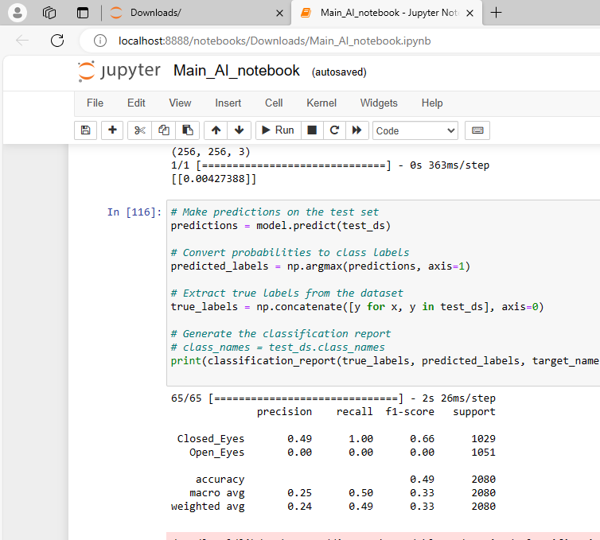
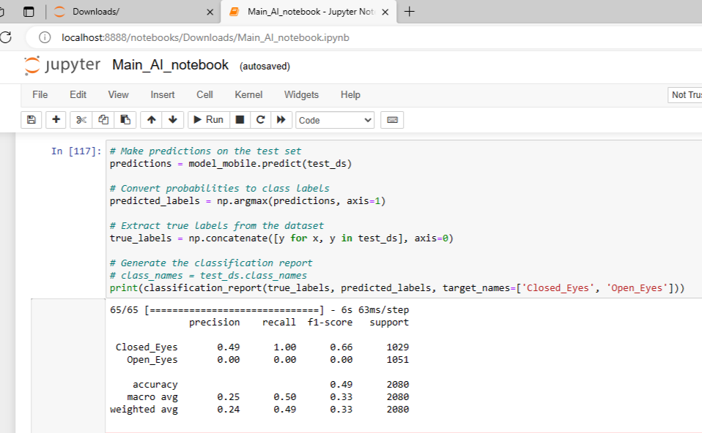
Evaluation
The models are evaluated using standard metrics such as accuracy and loss. Training and validation results are monitored across multiple epochs to assess model performance.

Slide 14
Model Deployment
Our DriveAlert Vigilance AI system incorporates a real-time application that plays a crucial role in enhancing road safety.
The real-time application continuously monitors the eye movements of drivers, aiming to detect signs of drowsiness promptly.
This real-time functionality significantly contributes to the overall effectiveness of DriveAlert Vigilance AI in preventing accidents caused by driver drowsiness.

Slide 15
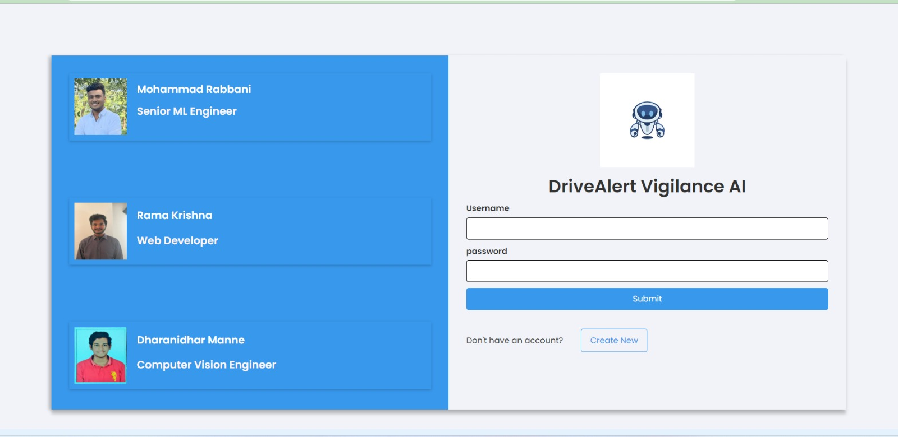
LOGIN PAGE :

Slide 16
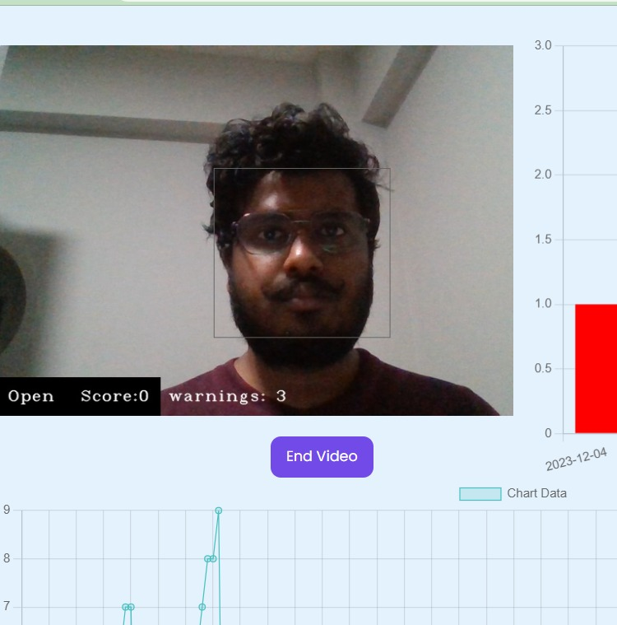
Continuous monitoring

Slide 17
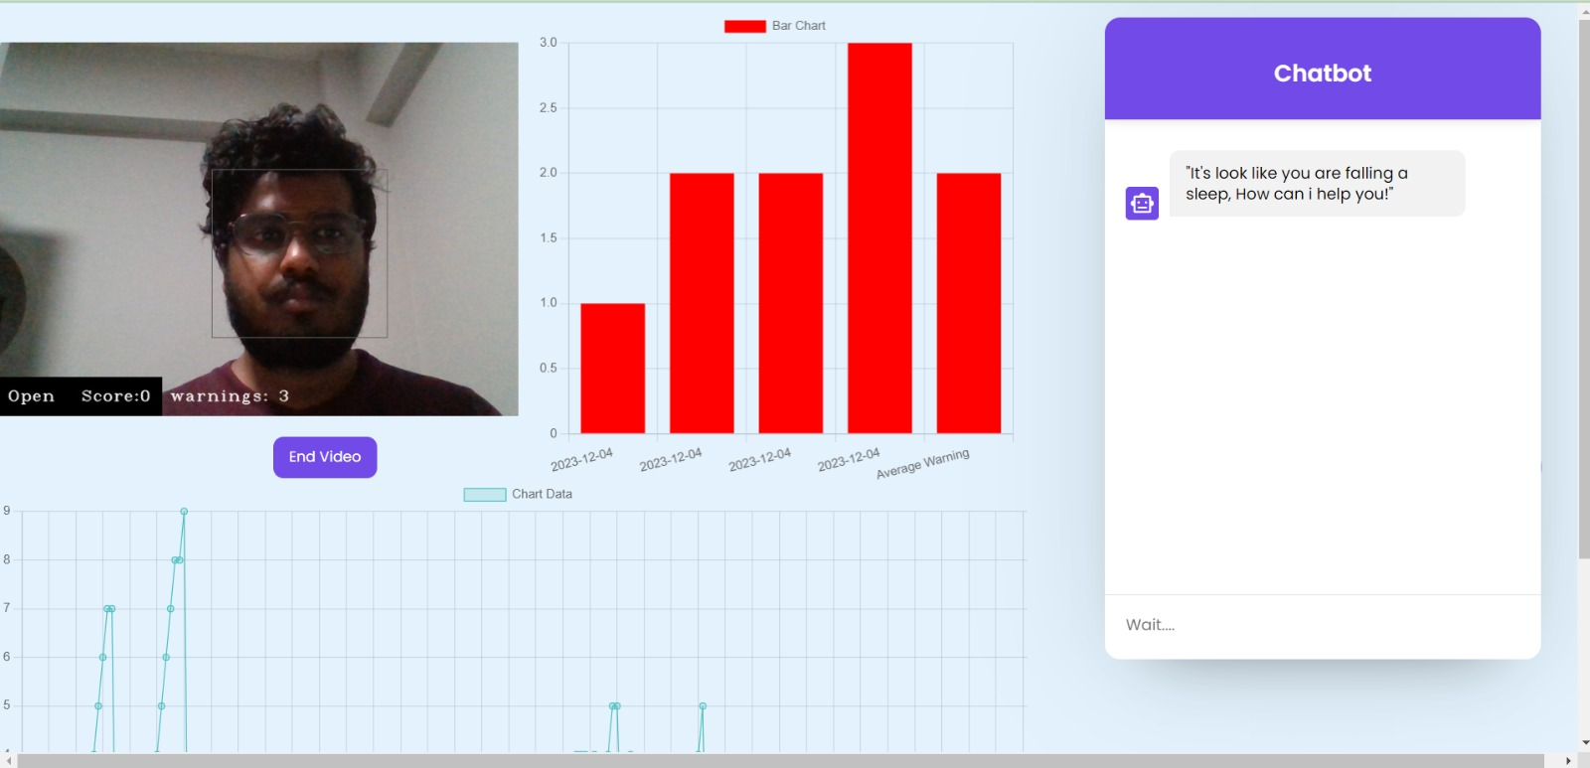
Chatbot interacting with driver to alert

Slide 18
Benefits of Drowsiness Detection
Improved Safety on the Road
Drowsiness detection technology can help prevent accidents caused by driver fatigue. By alerting drivers when they are showing signs of drowsiness, our application can help keep them and other drivers on the road safe.
Increased Productivity in the Workplace
Drowsiness can also be a problem in the workplace, particularly for jobs that require long hours or night shifts. Our application can help employees stay alert and focused, improving productivity and reducing the risk of accidents or errors.

Slide 19
CONCLUSION
We are trying to help people to come out from drowsiness while they were driving on the roads through our website. It prevents accidents & collisions of vehicles by alerting the drivers through chatbot from the fatigue and moreover helps us to save the lives of humans.

Slide 20

Thank You

